Slide 1
First principles
2021 November 8

Slide 2
Wazzup with the Debate Club?

Slide 3
Roland and tournaments
Central European Debate Tournament: Dec 4-5
Vitaméta judges: Nov 20, Nov 27, Dec 4, Dec 13
Other tournaments: Oxford IV, etc.

Slide 4
What should we focus with the debate soc?
Recruitment ideas? => accreditation => fill membership application
Dologi Pályázat: What do we need as a Debate Society? => Gonna ask you next week
Semester Closing Gala: Dec 13, Dec 20, Dec 27, price-range: 4-5k with dishes / catering → don’t come alone, find your +1 in time

Slide 5
Layout
Principled arguments
First principles
Practice
Revision
Kahoot

Slide 6
What are principled arguments?

Slide 7
What is a principled argument?
What are non-principled debates?
PA questions utility maximalisation
Utilitarianism: consequences maximize happiness
Weighing up is not easy → its not a goal
Importance of actors can still be utilitarian
Reparation debate:
OG: „obligation to women as MVM”
OO can either rebutt this or focus on women but can’t win only focusing on mens’ needs

Slide 8
What is a principled argument?
What are non-principled debates?
PA questions utility maximalisation
Utilitarianism: consequences maximize happiness
Weighing up is not easy → its not a goal
Importance of actors can still be utilitarian
Reparation debate:
OG: „obligation to women as MVM”
OO can either rebutt this or focus on women but can’t win only focusing on mens’ needs

Slide 9
What is a principled argument?
What are non-principled debates?
PA questions utility maximalisation
Utilitarianism: consequences maximize happiness
Weighing up is not easy → its not a goal
Importance of actors can still be utilitarian
Reparation debate:
OG: „obligation to women as MVM”
OO can either rebutt this or focus on women but can’t win only focusing on mens’ needs

Slide 10
Rebutting principles
Co-opting
Question thought-experiment
Provide contesting principles
Explain why you fulfill the principle better
Characterisation, f.e.: University professor whose wife cheats
Direct rebuttal
We are not used to it so we may find it hard – we do not have the societal intuitions yet
Show what other obligations do we have and weigh them up

Slide 11
Rebutting principles
Co-opting
Question thought-experiment
Provide contesting principles
Explain why you fulfill the principle better
Characterisation, f.e.: University professor whose wife cheats
Direct rebuttal
We are not used to it so we may find it hard – we do not have the societal intuitions yet
Show what other obligations do we have and weigh them up

Slide 12
Rebutting principles
Co-opting
Question thought-experiment
Provide contesting principles
Explain why you fulfill the principle better
Characterisation, f.e.: University professor whose wife cheats
Direct rebuttal
We are not used to it so we may find it hard – we do not have the societal intuitions yet
Show what other obligations do we have and weigh them up

Slide 13
Rebutting principles
Co-opting
Question thought-experiment
Provide contesting principles
Explain why you fulfill the principle better
Characterisation, f.e.: University professor whose wife cheats
Direct rebuttal
We are not used to it so we may find it hard – we do not have the societal intuitions yet
Show what other obligations do we have and weigh them up

Slide 14
What are first principles?
We want to address „deeper” goals in life rather than just explaining why B follows A.

Slide 15
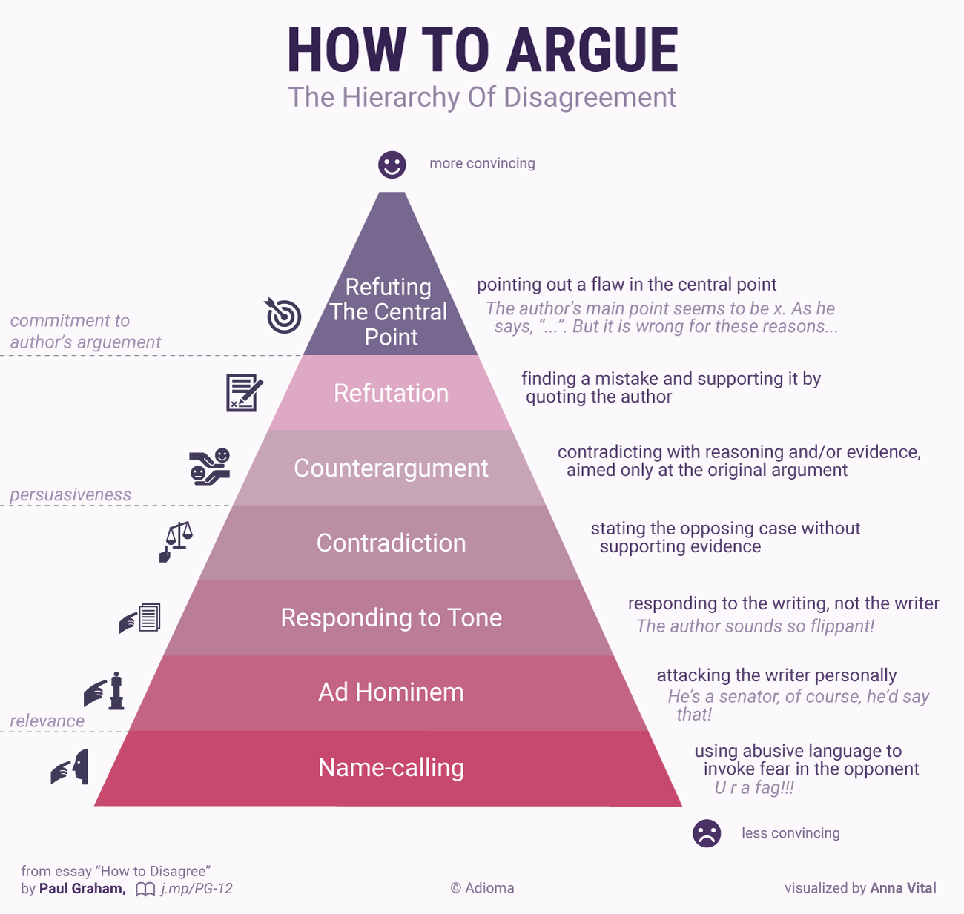
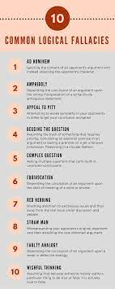

Slide 16
Every debate has been debated before...
First principles are like logical fallacies
Most people are stubborn about them
They do support hard-line cases
Part of the common knowledge and philosophers can stick them to you pretty hard

Slide 17
How to model the hardlines? „TH Supports Euthanasia”
Soft-line: Only for those on the verge of death, doctor’s consent, sound mind...
Hard-line: Also, for people diagnosed by mental illness (eg. Dementia)
Medium-line: Some restrictions, quick death...

Slide 18
How to model the hardlines? „TH Supports Euthanasia”
Soft-line: Only for those on the verge of death, doctor’s consent, sound mind...
Hard-line: Also, for people diagnosed by mental illness (eg. Dementia)
Medium-line: Some restrictions, quick death...

Slide 19
How to model the hardlines? „TH Supports Euthanasia”
Soft-line: Only for those on the verge of death, doctor’s consent, sound mind...
Hard-line: Also, for people diagnosed by mental illness (eg. Dementia)
Medium-line: Some restrictions, quick death...

Slide 20
Example: THW legalize drugs
What is the first principle here?

Slide 21
Freedom (to use drugs) III.
Proposition: characterization
Personal freedom allows people to do what makes them happy

Slide 22
Freedom (to use drugs) III.
Proposition: characterization
Personal freedom allows people to do what makes them happy
Opposition: refutation / rebutt
People ofthen make mistakes, and they might become unhappy

Slide 23
Freedom (to use drugs) III.
Judge: Status check
PROP Response: How would we know?
OPP Regulation: Maybe people misuse freedoms?
Whether people make more good or bad choices?
People know a lot more about themselves and their desires
Free choise lets us do what makes us happy
F.e.: Taking courselist for someone
Some people doesn’t know what they want
State has more information

Slide 24
Freedom (to use drugs) III.
Judge: Status check
PROP Response: How would we know?
OPP Regulation: Maybe people misuse freedoms?
Whether people make more good or bad choices?
People know a lot more about themselves and their desires
Free choise lets us do what makes us happy
F.e.: Taking courselist for someone
Some people doesn’t know what they want
State has more information

Slide 25
Freedom (to use drugs) III.
Judge: Status check
PROP Response: How would we know?
OPP Regulation: Maybe people misuse freedoms?
Whether people make more good or bad choices?
People know a lot more about themselves and their desires
Free choise lets us do what makes us happy
F.e.: Taking courselist for someone
Some people doesn’t know what they want
State has more information

Slide 26
Freedom (to use drugs) III.
Comparison: mechanism
# of people
Extent
Length
Likelihood

Slide 27
Freedom (to use drugs) III.
Comparison: mechanism
# of people
Extent
Length
Likelihood

Slide 28
Freedom (to use drugs) III.
Comparison: mechanism
# of people
Extent
Length
Likelihood

Slide 29
Freedom (to use drugs) III.
Comparison: mechanism
# of people
Extent
Length
Likelihood

Slide 30
Freedom (to use drugs) III.
Comparison: mechanism
# of people
Extent
Length
Likelihood

Slide 31
Parent-model: Pincipled-argument has 3 parts
Statement of principle
Defense of principle
Comparison

Slide 32
Parent-model: Pincipled-argument has 3 parts
Statement of principle
Defense of principle
Comparison
Statement of principle
Defense of principle
Comparison

Slide 33
Parent-model: Pincipled-argument has 3 parts
Statement of principle

Slide 34
Parent-model: Pincipled-argument has 3 parts
Statement of principle

Slide 35
Parent-model: Pincipled-argument has 3 parts
Forward
Statement of principle

Slide 36
Practice of first principles
Should we take the kidney of a person under anastesia?
„No, because I am not just an object”

Slide 37
Choose a topic of these and practice first principles together!
Debate topics
THBT the state should not pursuit equality of income
THS a world where noone can keep their children
THW only provide group grades rather than individual grades
THR the rapid advancement of technology
THP a world where people are legally forced to only have sex with 1 person every month
THW give death penalty for every crime
THW set up bad jails rather than good jails
TH as a US citizen Regrets that US citizens can only get elected twice
Debate Club topics:
THW make debating a school subject
THBT we should ask for a 500 HUF entrance fee before every debate session
THBT we should kick out people of the debate meetings who are not accepted by the admission board
THBT debate workshops should focus more on non-cometitive-debate-specific knowledge, with invitation of external guests rather than the status quo
First principles
Democracy is good / bad
Security is good / oversecuritization is bad
Universal human rights is good / bad
Religious freedom is good / bad
Antiracism with affirmative action is good / bad

Slide 38
THR the rapid advancement of technology

Slide 39
What to do checklist
Principle pro:
Rebutt opp:
Response pro:
Regulation opp:
Comparison neutral:
How the gov world should be?
How the opp world should be?
Motion where it comes up:

Slide 40
Revision of semester so far

Slide 41
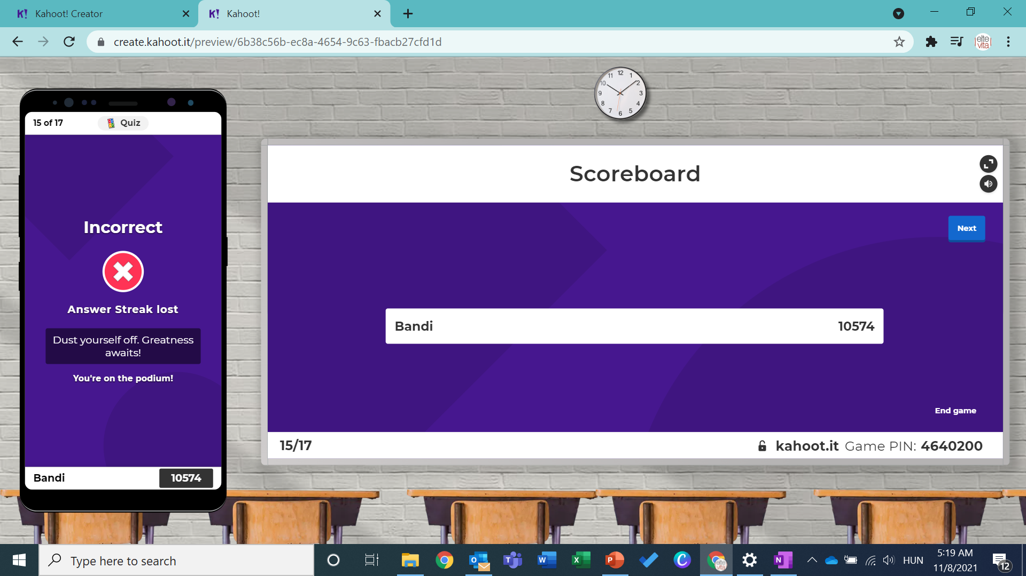

Slide 42
Level 2 of the workshop:
Manchaster advanced debate trainings
Common non-utilitarian claims
Applications of principles
Find it:
https://www.youtube.com/watch?v=K5Ia7Z-Urbc

Slide 43
Let’s do some revision
https://create.kahoot.it/share/first-principles/6b38c56b-ec8a-4654-9c63-fbacb27cfd1d

